Slide 1

Regularization for Variable Selection in Multidimensional Factor and Network Models
Jiaying Chen
Xinya Liang, Ph.D
Jihong Zhang, Ph.D

Slide 2
Introduction
Variable selection is crucial for achieving model simplicity by reducing the number of items included in the analysis, helping to create a more interpretable and efficient model (Jacobucci et al., 2016 ;Wille, 1996).
Both FA and Network Analysis can incorporate regularization techniques (e.g. Lasso) to aid in simplifying models by penalizing less important parameters, thereby enhancing model estimation and preventing potential overfitting.
How regularized factor and network analysis perform in terms of variable selection in instruments developed through the factor analytic framework, particularly across unidimensional and multidimensional structures, remains understudied.

Slide 3
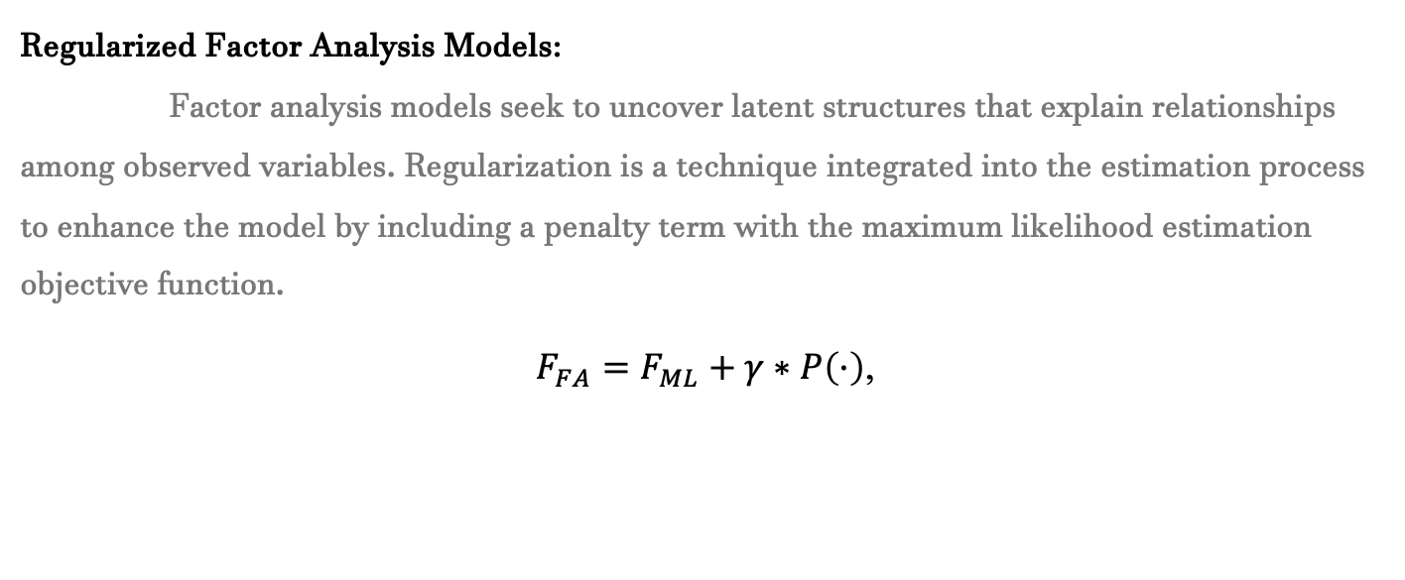
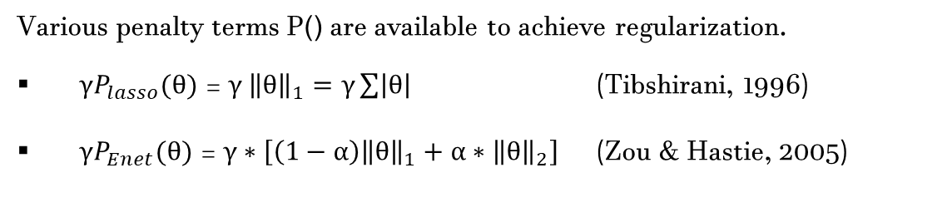
Background information
Regularized Factor Analysis Models:
Factor analysis models seek to uncover latent structures that explain relationships among observed variables. Regularization is a technique integrated into the estimation process to enhance the model by including a penalty term with the maximum likelihood estimation objective function.
$F_{FA}=F_{ML}+γ∗P\left(·\right)$,
Various penalty terms P() are available to achieve regularization.
${γP}_{lasso}(θ)$ = $γ {\left\|θ\right\|}_{1}=γ\sum{\left|θ\right|}$ (Tibshirani, 1996)
${γP}_{Enet}(θ)$ = $γ∗\left[\left(1−α\right){\left\|θ\right\|}_{1}+α∗{\left\|θ\right\|}_{2}\right]$ (Zou & Hastie, 2005)

Slide 4

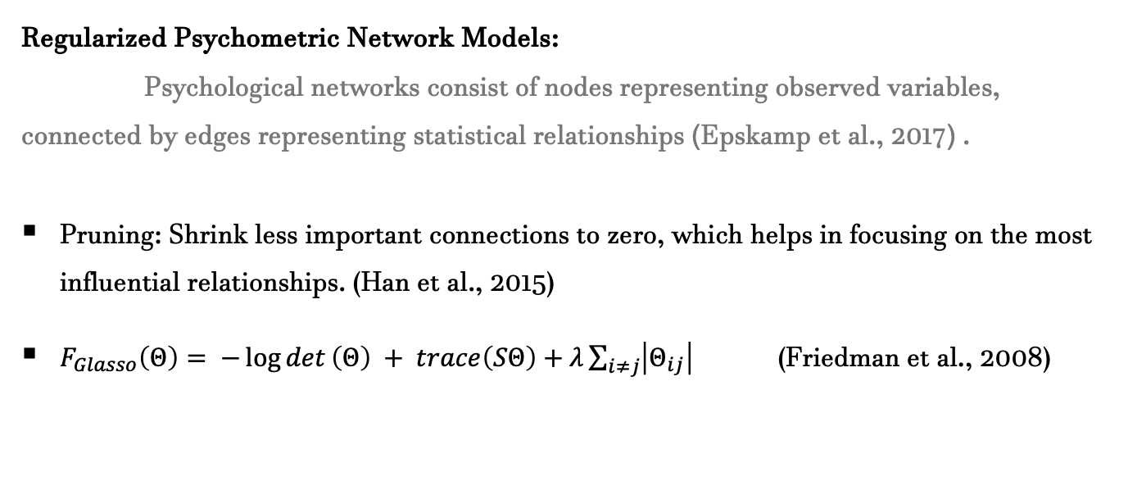
Background information
Regularized Psychometric Network Models:
Psychological networks consist of nodes representing observed variables, connected by edges representing statistical relationships (Epskamp et al., 2017) .
Pruning: Shrink less important connections to zero, which helps in focusing on the most influential relationships. (Han et al., 2015)
$F_{Glasso}\left(Θ\right)= −\log{det}\left(Θ\right) + trace\left(SΘ\right)+λ\sum_{i≠j}{\left|Θ_{ij}\right|}$ (Friedman et al., 2008)

Slide 5
Purpose of study
Aim 1: Compare the efficacy of variable selection in regularized factor analysis vs. network analysis under single and multidimensional contexts.
Aim 2: Explore how regularized network models can inform variable selection in data generated with latent structures.

Slide 6
Study design
Data were generated in R 4.3.3 with the lavaan package (Rosseel, 2012).
Population model:
one-factor model with 24 normally distributed items (0.7 /0.2, 0.1, 0) .
three-factor model with 8 items for each factor (0.7 /0.2, 0.1, 0).
three-factor model with 8 items for each factor (one cross loading each factor )
Sample size : 200, 500, 1000
Replications: 100

Slide 7
Data analysis
Data were analyzed in R 4.3.3 with the following packages (Rosseel, 2012) .
Network Analysis Method:
Prune in ‘psychonetrics’: τ =0.01
Glasso in ‘bootnet’: γ= 0.5
Factor Analysis Method:
Lasso and Elastic net in ‘regsem’, ‘penfa’, and ‘lslx’ packages
lambda.start= 0.001, jump = 0.01, n.lambda = 50
Elastic net alpha = 0.5
Threshold = 0.1 (zhang, 2021)

Slide 8
R package
 | Factor analysis
 | Lasso | ElasticNet
regsem | √ | √
panfa | √ | --
Lslx | √ | √
 | Network analysis
psychonetrics | prune
bootnet | glasso

Slide 9
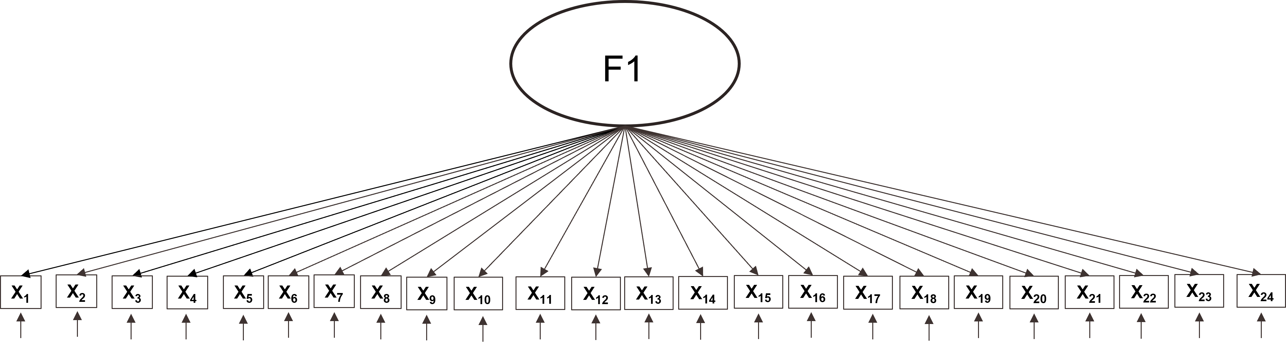
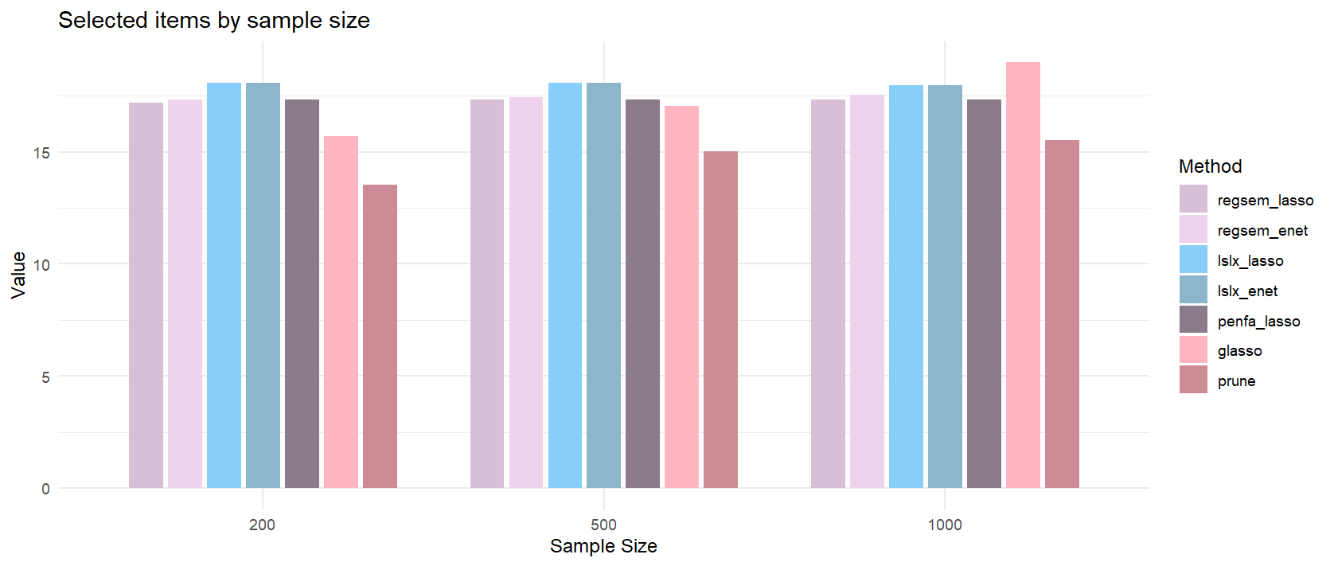
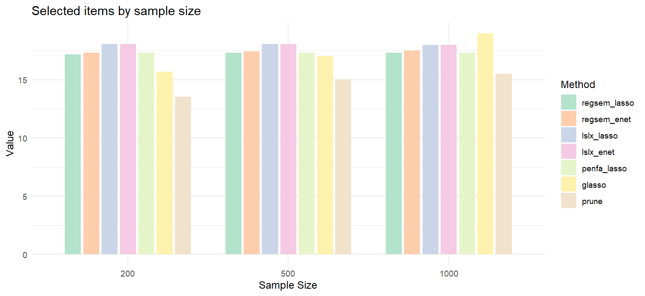
Results (one factor model)
Non-zero items = 20

Slide 10
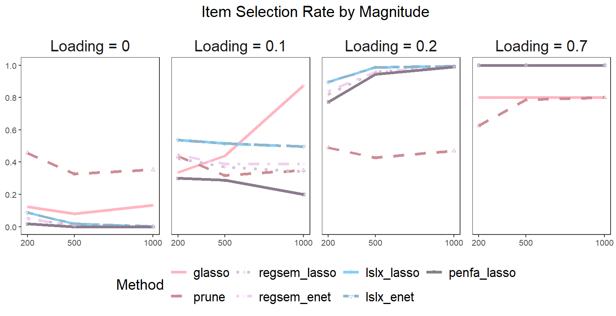
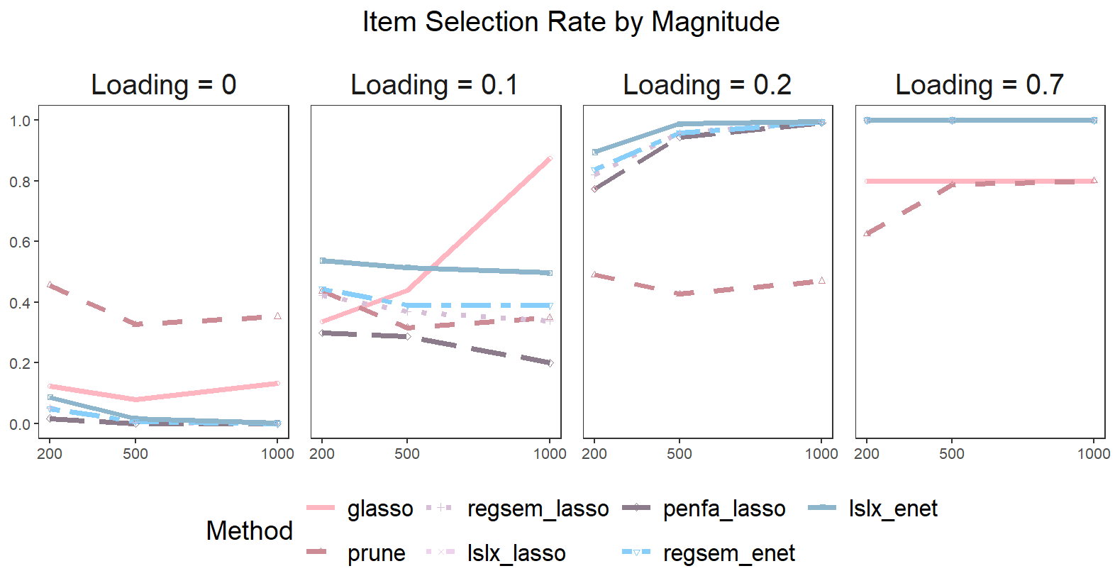
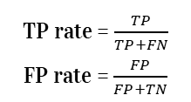
Results (one factor model)
TP rate = $\frac{TP}{TP+FN}$ FP rate = $\frac{FP}{FP+TN}$

Slide 11

Results (one factor model)
BIC 500
BIC 200
BIC 1000
 | regsem | penfa | lslx
lasso | 31389.28 | 31415.94 | -2.60
enet | 31390.26 | -- | -2.61
 | psycho | bootnet
prune | 32219.32 | --
glasso | -- | 10235.49
 | regsem | penfa | lslx
lasso | 12647.57 | 12671.26 | -5.32
enet | 12648.74 | -- | -5.32
 | psycho | bootnet
prune | 13359.13 | --
glasso | -- | 4530.318
 | regsem | penfa | lslx
lasso | 62637.7 | 62642.92 | -1.48
enet | 62638.63 | -- | -1.49
 | psycho | bootnet
prune | 63230.48 | --
glasso | -- | 19606.96
For Glasso, the number demonstrate EBIC

Slide 12
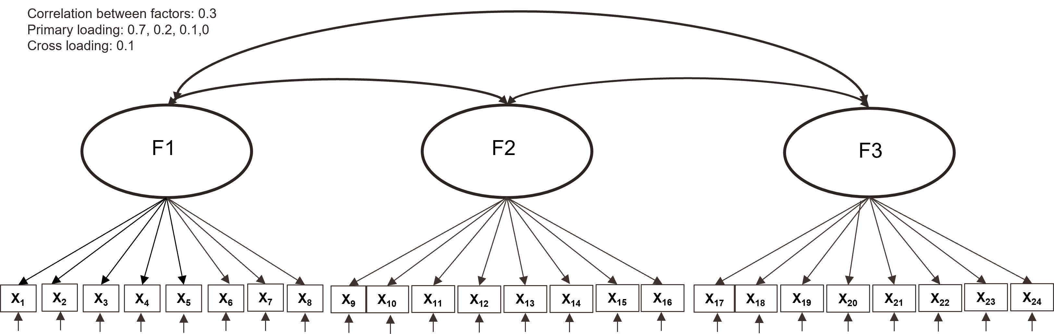
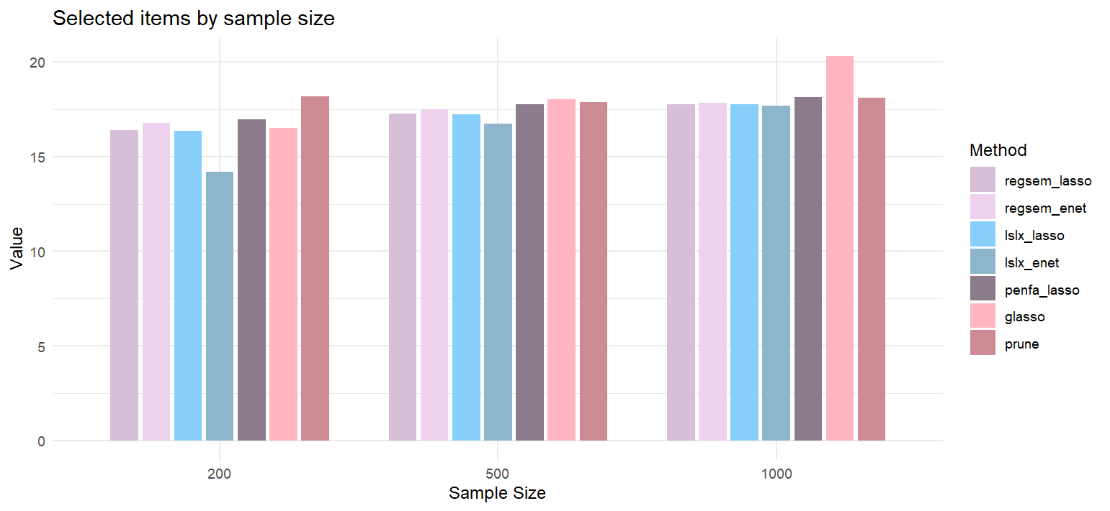
Results (three factor model)
Non-zero items = 21

Slide 13
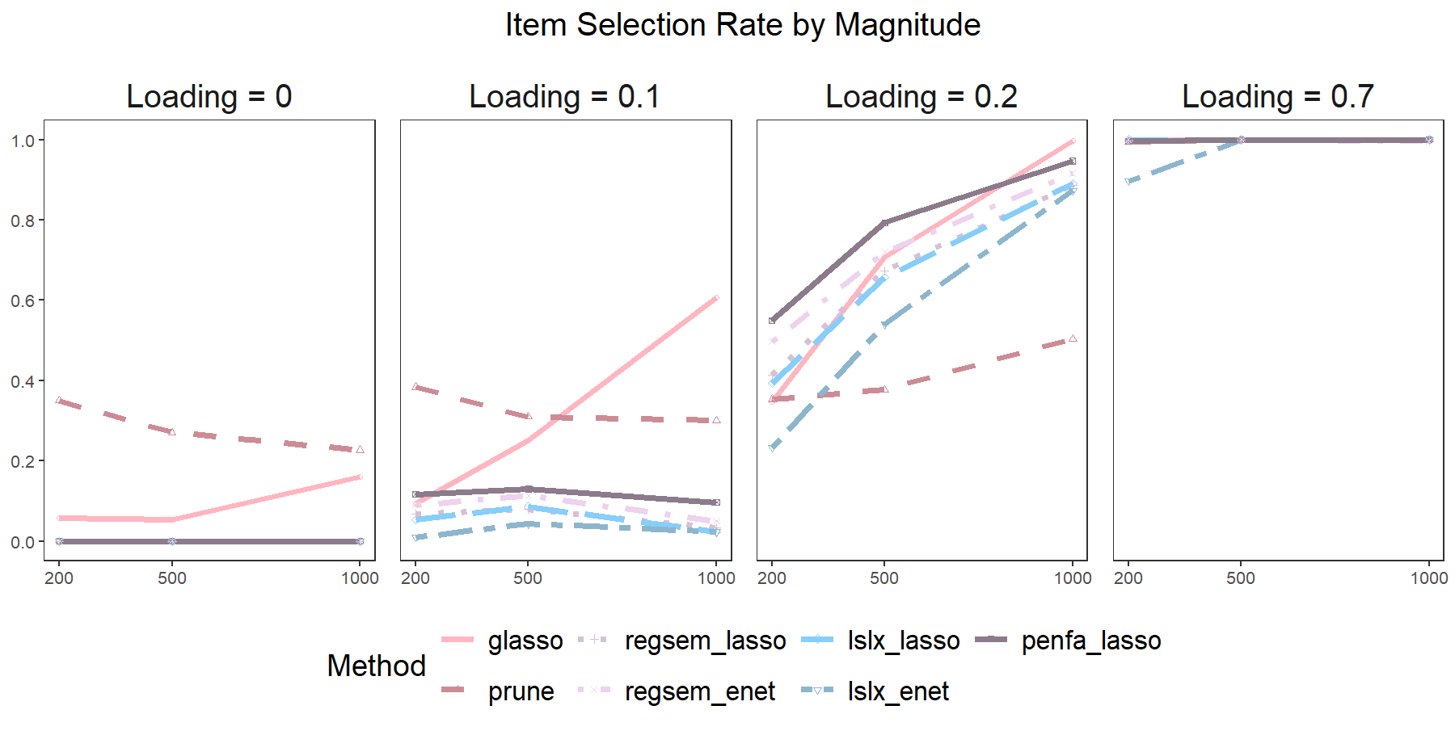
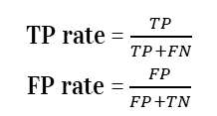
Results (three factor model)
TP rate = $\frac{TP}{TP+FN}$ FP rate = $\frac{FP}{FP+TN}$

Slide 14
Results (three factor model)
BIC 500
BIC 200
BIC 1000
 | regsem | penfa | lslx
lasso | 31795.53 | 31754.46 | -2.44
enet | 31813.92 | --- | -2.49
 | psycho | bootnet
prune | 32010.30 | --
Glasso | -- | 10283.80
 | regsem | penfa | lslx
lasso | 12839.57 | 12809.32 | -5.00
enet | 12856.84 | --- | -5.31
 | psycho | bootnet
prune | 13008.36 | --
glasso | -- | 4404.95
 | regsem | penfa | lslx
lasso | 63373.67 | 63345.49 | -1.38
enet | 59539.67 | --- | -1.38
 | psycho | bootnet
prune | 63700.98 | --
glasso | -- | 20015.60
For Glasso, the number demonstrate EBIC
AERA 2025

Slide 15
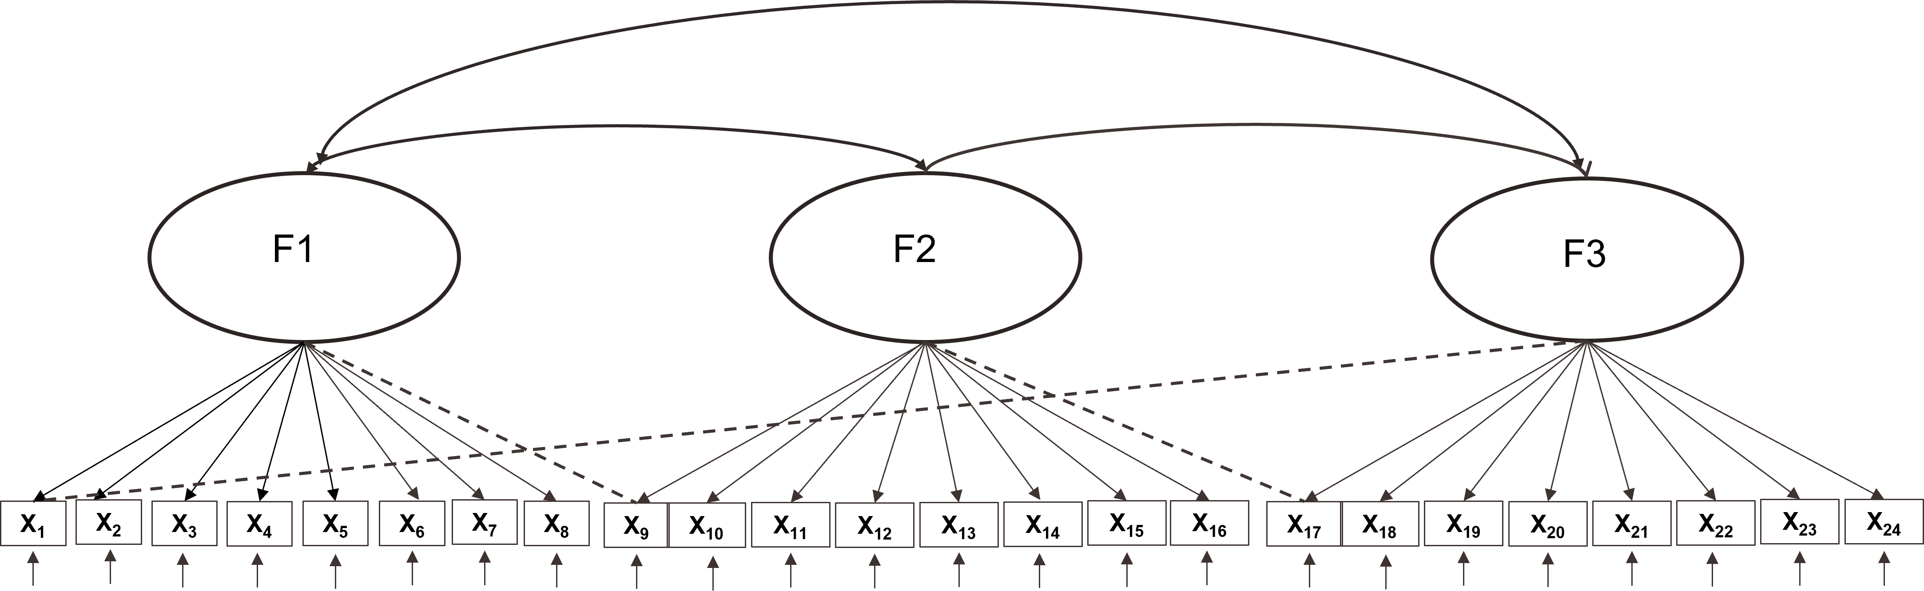
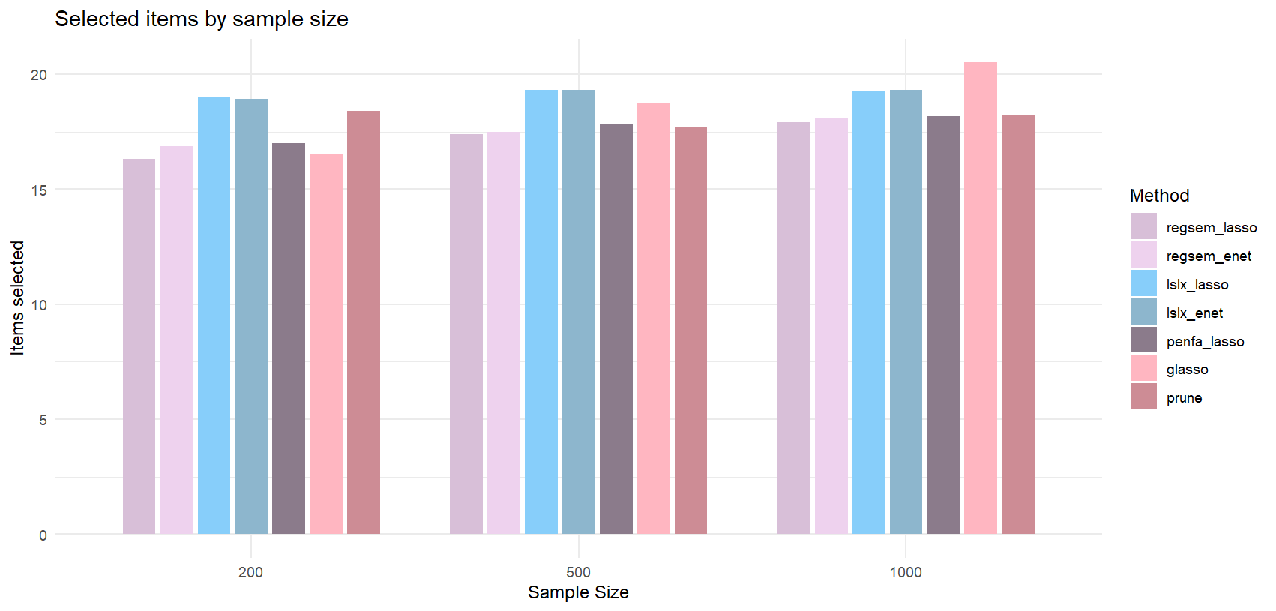
Results (three factor model with cross-loading)
Non-zero items = 21

Slide 16
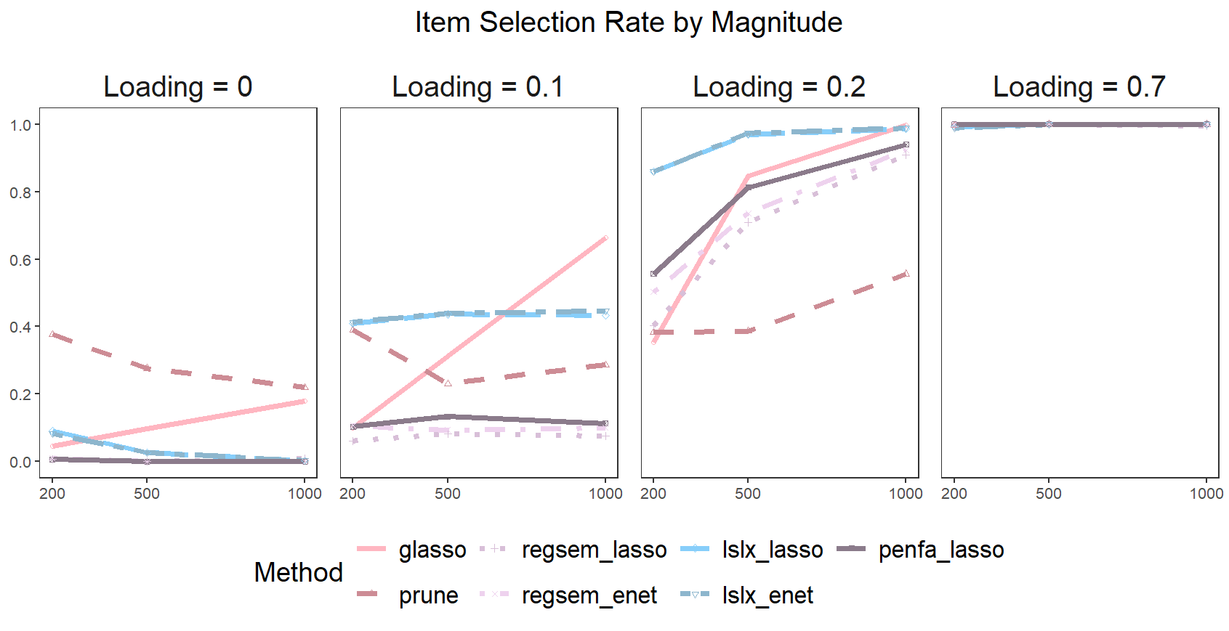
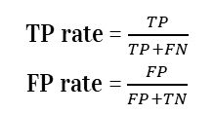
Results (three factor model with cross-loading)
TP rate = $\frac{TP}{TP+FN}$ FP rate = $\frac{FP}{FP+TN}$
AERA 2025

Slide 17
Results (three factor model with cross-loading)
BIC 500
BIC 200
BIC 1000
 | regsem | penfa | lslx
lasso | 31682.76 | 31648.75 | -2.19
enet | 31700.66 | --- | -2.18
 | psycho | bootnet
prune | 31920.35 | --
Glasso | -- | 10199.20
 | regsem | penfa | lslx
lasso | 12805.89 | 12763.41 | -4.40
enet | 12522.44 | --- | -4.40
 | psycho | bootnet
prune | 12972.78 | --
glasso | -- | 4380.27
 | regsem | penfa | lslx
lasso | 62130.97 | 63046.82 | -1.25
enet | 63154.30 | --- | -1.24
 | psycho | bootnet
prune | 63492.08 | --
glasso | -- | 19692.90
For Glasso, the number demonstrate EBIC
AERA 2025

Slide 18
Takeaway
Conclusion：
Factor analysis perform reliably in small samples, making them suitable for studies with limited data. However, when sample size increase for multidimensional data, regsem and penfa may prefer to be more conservative than glasso.
Network methods tends to over select more noise variables (items with small loadings), especially for larger samples. Glasso’s adaptive regularization allows it to recover more variables as data grows, while fixed-threshold pruning falls behind.
Network methods struggle to detect strong loadings in unidimensional models due to high factor correlation but achieve better performance in multidimensional models.
Future direction：
Different types of model misspecification or item characteristics

Slide 19
Thank you
Jiaying Chen jc168@uark.edu
Xinya Liang xl014@uark.edu
Jihong Zhang jzhang@uark.edu

